Slide 1
Lecture 6
Network Models of Cities
6.3 Four Principles: Individual Cognitive and Behavioral Constraints
©Luís M. A. Bettencourt 2023
Notes:
This module is more qualitative and deals with background concepts in social psychology about changes of behavior in cities, and possible underlying reasons why the environments of cities cause specific human adaptations. The focus is on the limitations of effort and mental capacity.

Slide 2
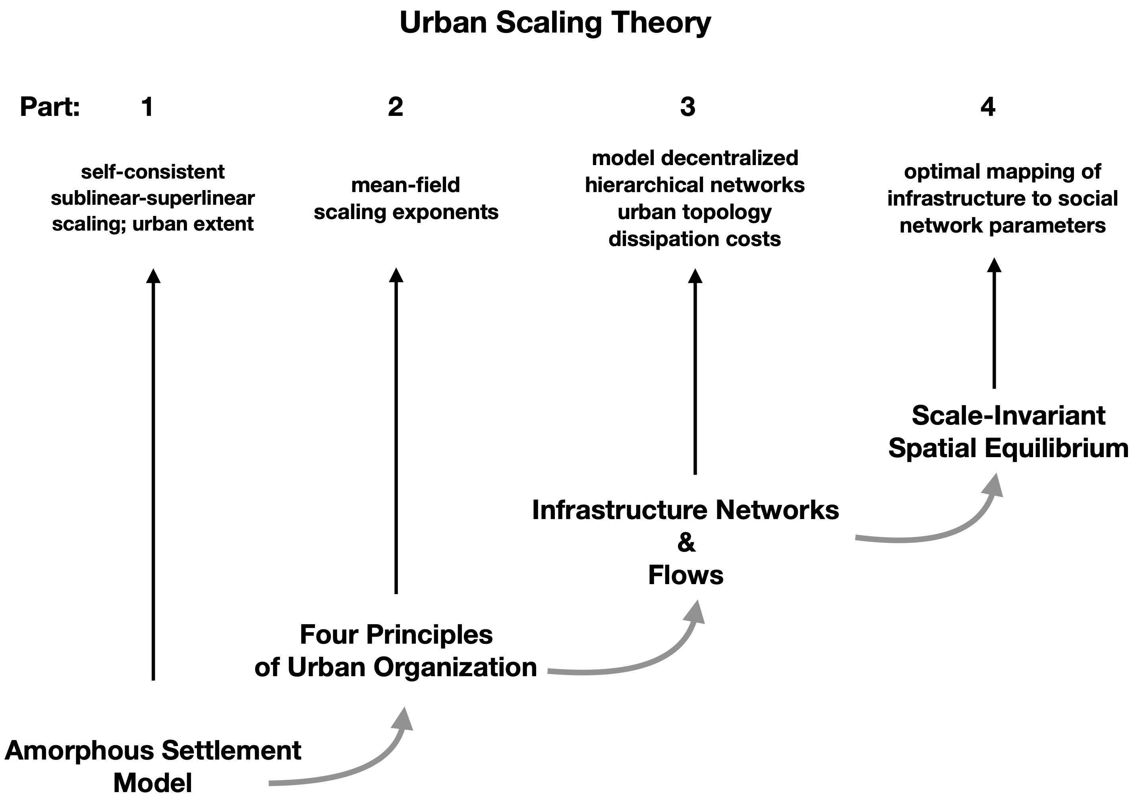

IUS Figure 3.5
Notes:
We start my motivating 4 principles that we will use to develop urban scaling theory.

Slide 3
Four Principles of Urban Organization
1) Cities are mixing populations (networks) over built space and time
2) Personal effort is limited
3) City infrastructure as decentralized but hierarchical networks
4) Socioeconomic products of cities are the result of interactions,
subject to spatial costs
Jacobs, Wirth, Burgess
Park, Milgram, Zahavi, Simon
Alexander
Jacobs
Alonso
already in the amorphous model, but more to come…
Notes:
These four principles are well motivated by previous well-known work, but we will use them in a more quantitative way as we go forward. The first principle was already demonstrated for the amorphous model, so we will hold on that for now. We move on to the second:

Slide 4
2) Personal effort is limited
Changes in Human Cognition and Psychology in the City

Slide 5
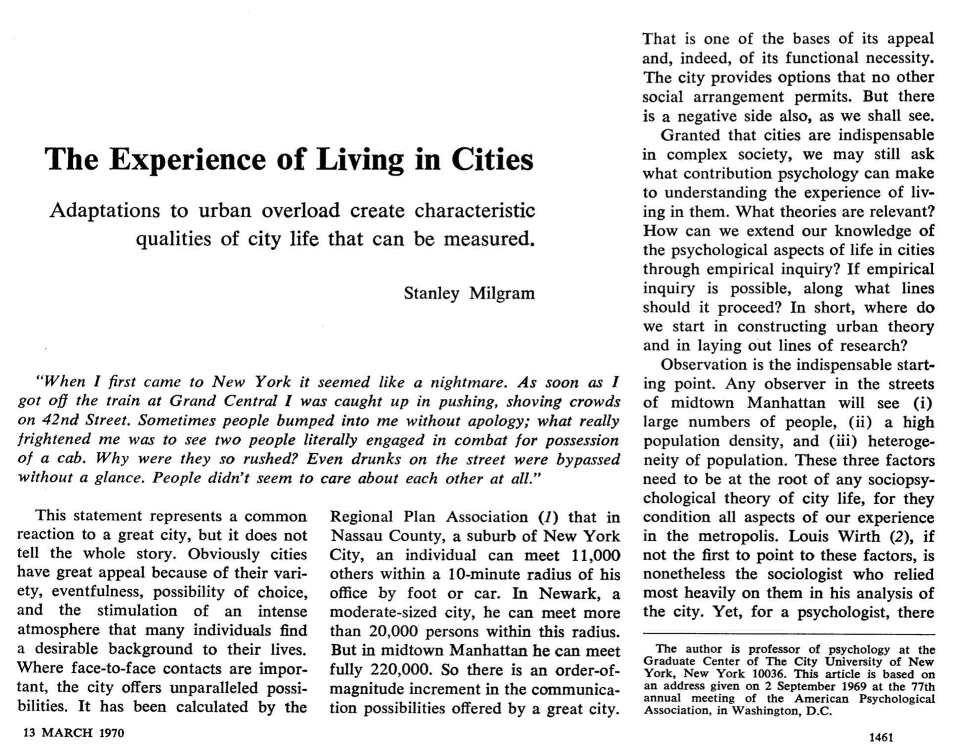








One of the greatest papers on social psychology:
More Choice/“Freedom “
Reading Materials
where did you see this?
larger networks (potentially)!
https://www.science.org/doi/10.1126/science.167.3924.1461
Notes:
This is one of the most famous papers in social psychology relating to cities (by the famous Stanley Milgram). His main focus is on the concept of mental overload as a constraint that leads to adaptation.

Slide 6
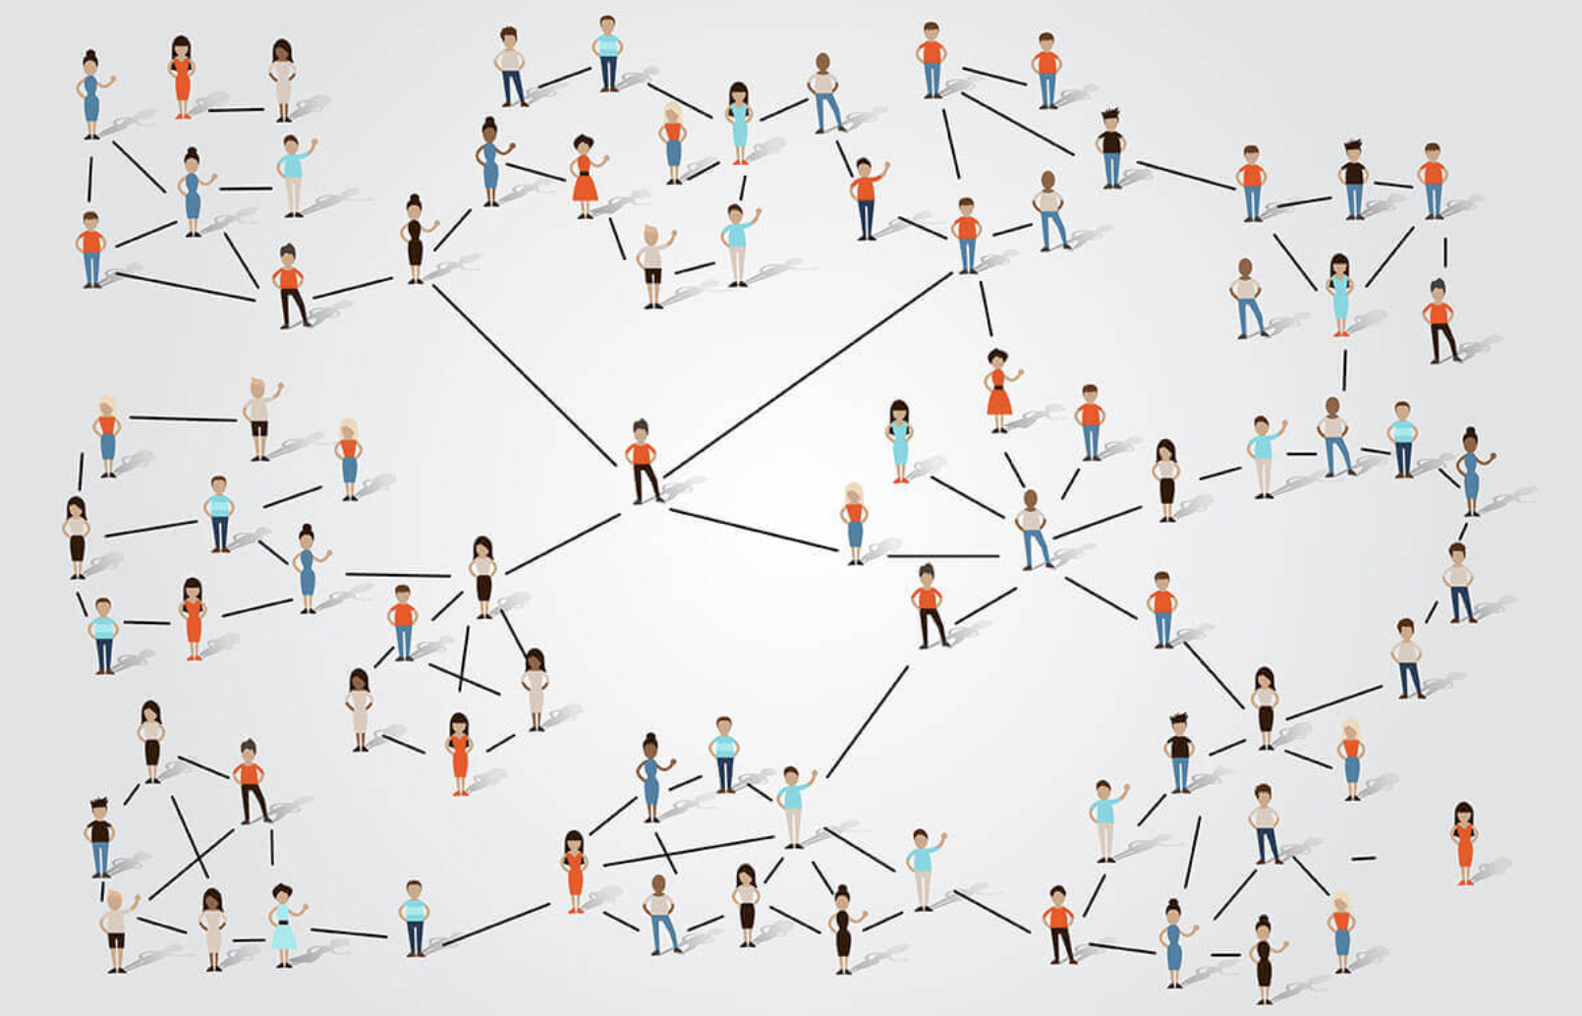
credit: HackerEarth.com
“6 degrees of separation”
Social Networks are Small Worlds
link distance between people is $∼lnN$

Slide 7
Adaptive behavioral in cities responses to cognitive “overload” (Milgram)
allocation of less time per input
disregard for low priority inputs
boundaries are redrawn so as to distribute overload
reception is blocked off
intensity of inputs diminished by filtering devices
specialized institutions arise to deal with inputs
busyness
callousness
somebody else’s problem
indifference
“headphones on bus”
institutionalized social services
https://www.science.org/doi/10.1126/science.167.3924.1461
Notes:
This is from Milgram’s article and is supposed to help explain some characteristics of behavior in larger cities.

Slide 8

population scale
density
heterogeneity
Cognitive
Overload
Experience of Living in Cities
Wirth
General Urban
Behavioral
Adaptations
Experiments and data on:
bystander intervention in dangerous situations
willingness to trust and assist strangers
civilities
anonymity
role behavior
tolerance
There’s a science to all this
“good” & “bad”
Can all be measured !
Psychology needs an idea that links the individual’s experience
to the demographic circumstances of urban life.
Milgram: When Overload is present Adaptations Occur.

Slide 9
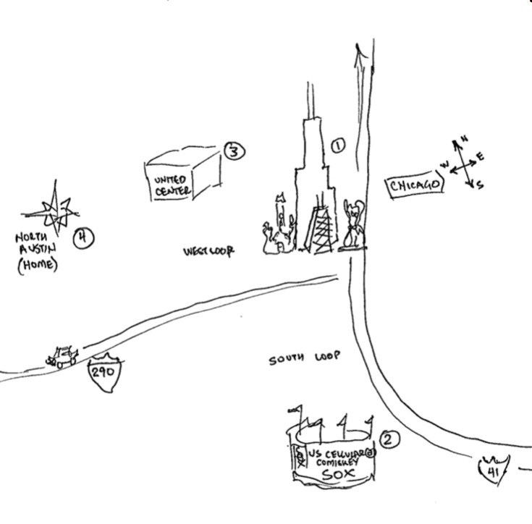

Not quiet all about “overload”:
Other Aspects of the Urban Experience:
The Atmosphere of Great Cities
Experimental Comparisons in Behavior
Tempo and Pace
Visual Components
Ambiance
Cognitive Maps of Cities (legibility)
the city becomes “symbolic”
Kevin Lynch: Image of the City
In Manhattan an individual can meet 220,000 others in a 10 minute radius of their office
The City Provides Options that no Other Social Arrangement Permits

Slide 10
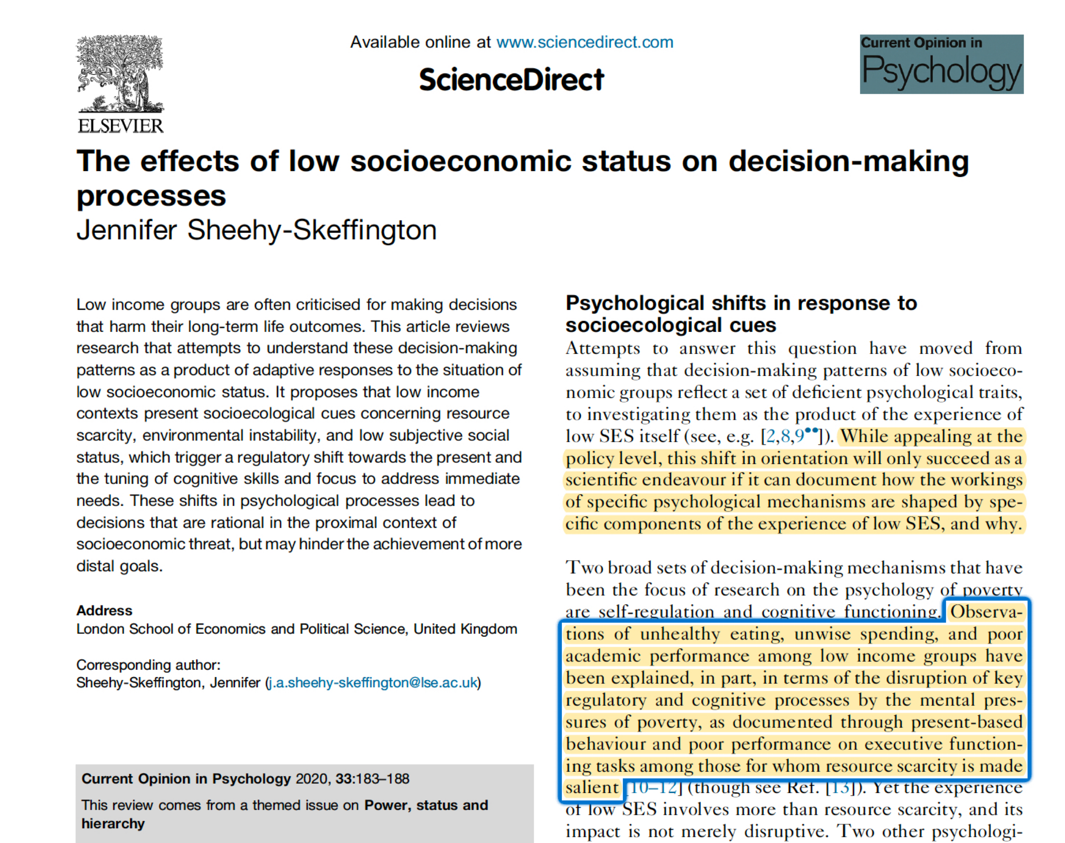
shift away from lack of “rationality”
and “cognitive biases”
https://www.sciencedirect.com/science/article/pii/S2352250X1930123X?via%3Dihub
Notes:
More recent work (not explicitly about cities) explores how low socioeconomic status also frames people’s decisions, in a way that is adaptive and NOT irrational.

Slide 11
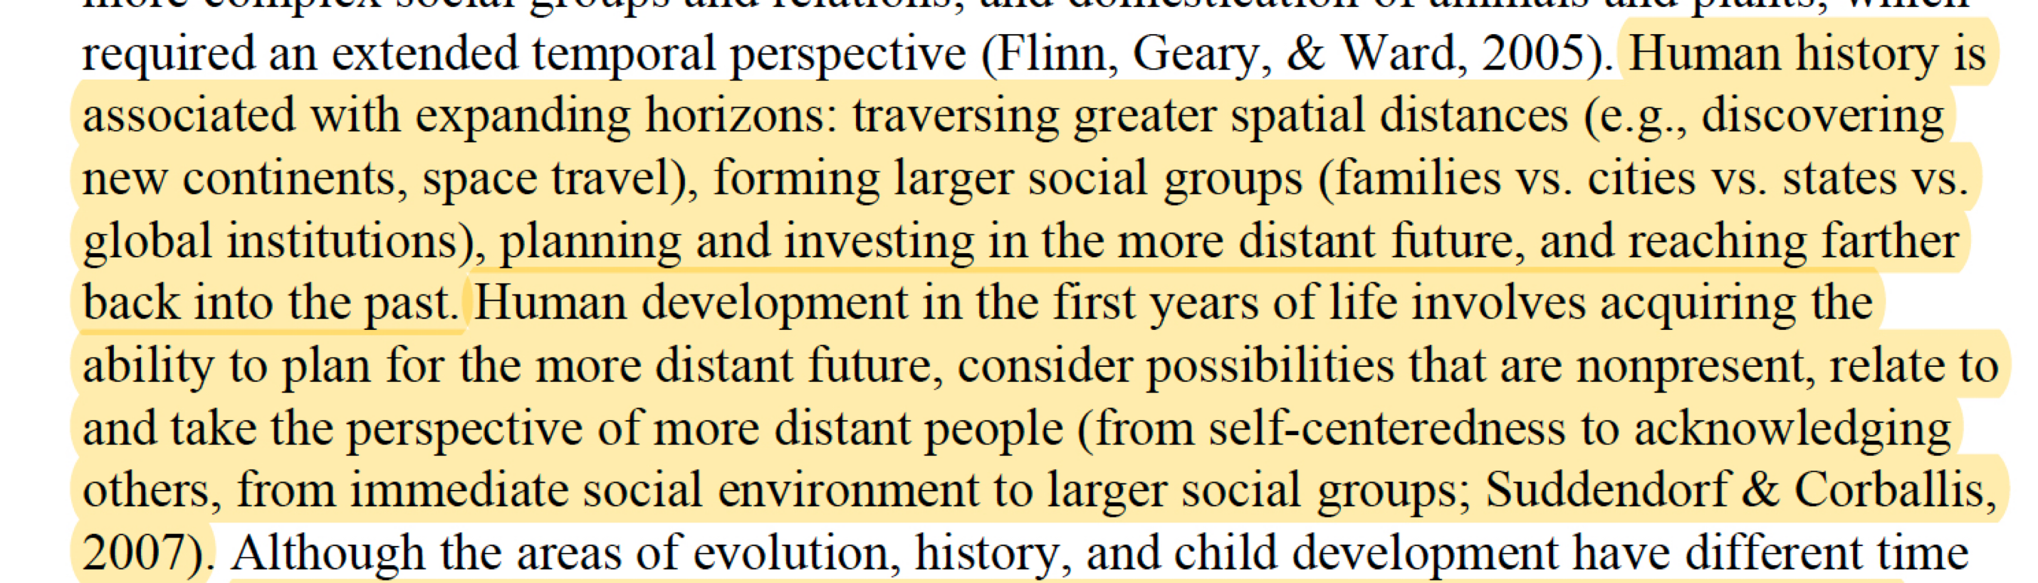
Levels of Construal, Psychological Distance and Cities:
Psychologists talk in terms of 4 dimensions of Psychological Distance:
Spatial : Near vs Far
Temporal : Now vs Later
Social: Familiar vs Stranger
Hypothetical: Certain vs Unlikely
They are all connected
living in (larger) cities forces us to traverse larger psychological distances
Collective and personal human development
are associated with traversing increasingly greater distances:
Trope + Liberman, Psychol Rev 2010
https://content.apa.org/record/2010-06891-005
Notes:
By squeezing in people in space and time, cities also introduce longer perspective that lead to change and development. These are sometimes described by psychologists as higher construals.

Slide 12
There are always limits to (cognitive) human effort for individuals
How is a life with open-ended creativity, novelty and more information possible?
Cities expose the limits of human cognition by creating psychological overload
but they also need to create opportunities and barriers, along with shortcuts in psychological distance,
by concentrating diversity
stark limits in every day life
Urban environments create, at once
no contradiction, just a matter of time scale
new pathways for development over longer times
There is a “connectivity budget “ that needs to be well allocated : $G$ is conserved across city size
Notes:
This makes the general argument that the constraints of cities on people are very real, but also that some of the adaptations are functional and can lead to development: these are yet to be properly recognized in social decision theory (such as rational choice theory and behavioral economics), so studying human cognition and behavior in cities is likely to be enormously productive of new discoveries about human nature.

